Slide 1


Steven Moran & Garland McNew
Visualizing WALS Data
Notes:
<number>

Slide 2
Outline
Some criticisms
Visualizations
Base map creation
Methods for visualizing linguistic data
Moving forward
Notes:
<number>

Slide 3
Some criticisms
Idiosyncratic decision on the types (typological variables)
Uneven distribution(s) of the language data
Statistical sampling issues for typological data
Languages as points
Drawing conclusions from visualizations that lack data
Notes:
<number>

Slide 4
Drawing conclusions from visualizations
Problems testing typological correlations with the online (Dryer)
overall numbers may suggest a correlation
illusions arise because of the (lack of) languages
WALS chapter 130
Notes:
<number>

Slide 5
How to visualize language genealogy and areality?
Sunburst explorer (Mayer et al)
Can we take this idea further?
What else can we learn from cartographers?
Notes:
<number>

Slide 6
What is at the core of this visualization?
Areal visualization, Areal typology
“All” language distribution as per Glottolog database
Explore WALS typological features distribution
Identify global and regional sampling bias: both in the Glottolog dataset and joined WALS typological feature dataset
Remove symbology overlap and create discrete representations of data points and typological features
Notes:
<number>

Slide 7
Creating the base map
Cartography and map making is often times about compromise
Many times there’s a distortion of truth/reality
The goal is to reach a reasonable effective compromise for the intended purpose of the map or visualization
Map projections are a perfect example of this challenge
Notes:
<number>

Slide 8
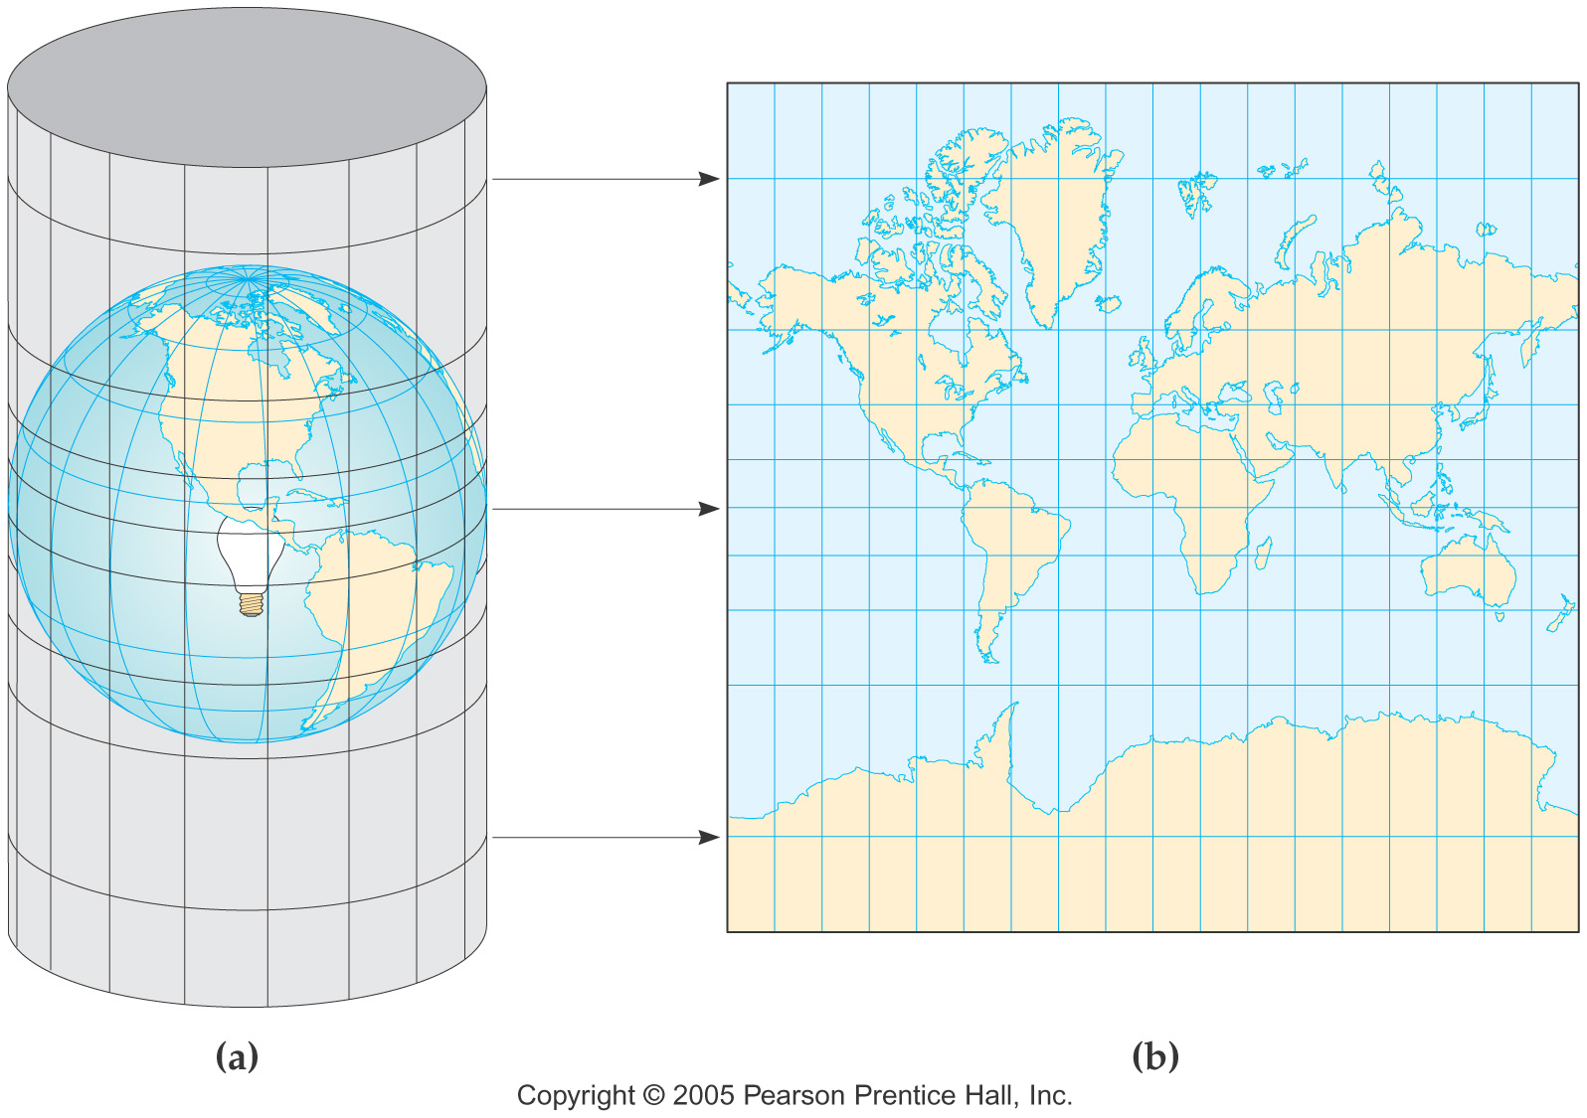
What is a projection?

Slide 9
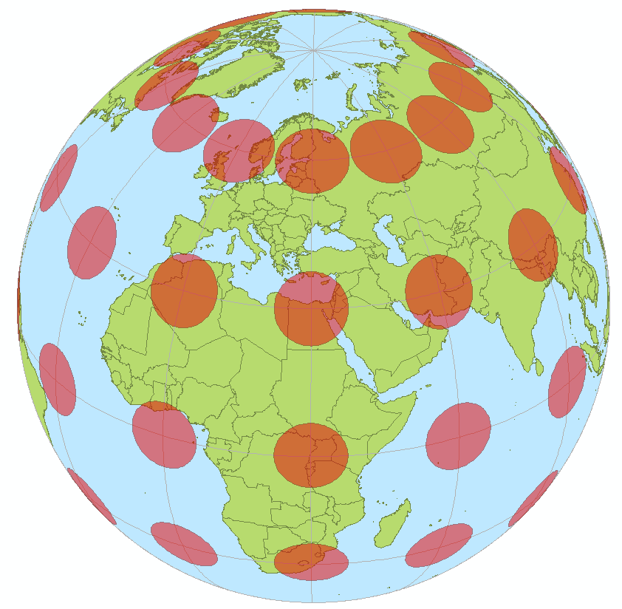
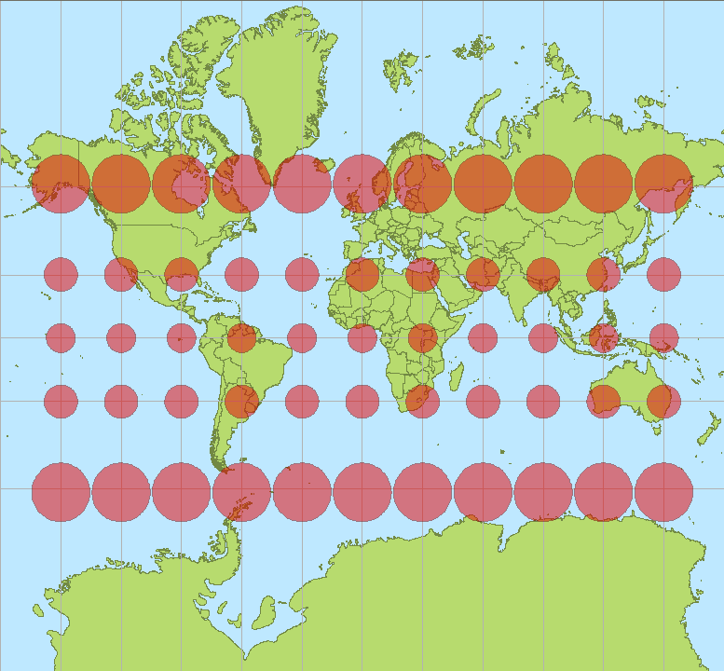
Mercator Projection
Notes:
<number>

Slide 10
So why is distortion a problem?
Should never be used for density visualization purposes
Points are “pulled” or “stretched” away from one another visually when plotting them on a Cylindrical/Mercator type projection
Although positionally accurate, the areal distortion creates an erroneous perspective of density
Two points of equal distance will appear more clustered near the equator than they would near the poles.
Notes:
<number>

Slide 11
Solution
Equal area projection (Eckert IV)
Preserves land mass/object size but highly distorts lines of constant course (rhumb lines)
For this application we are not concerned with maritime navigation so this would be an acceptable compromise
Notes:
<number>

Slide 12
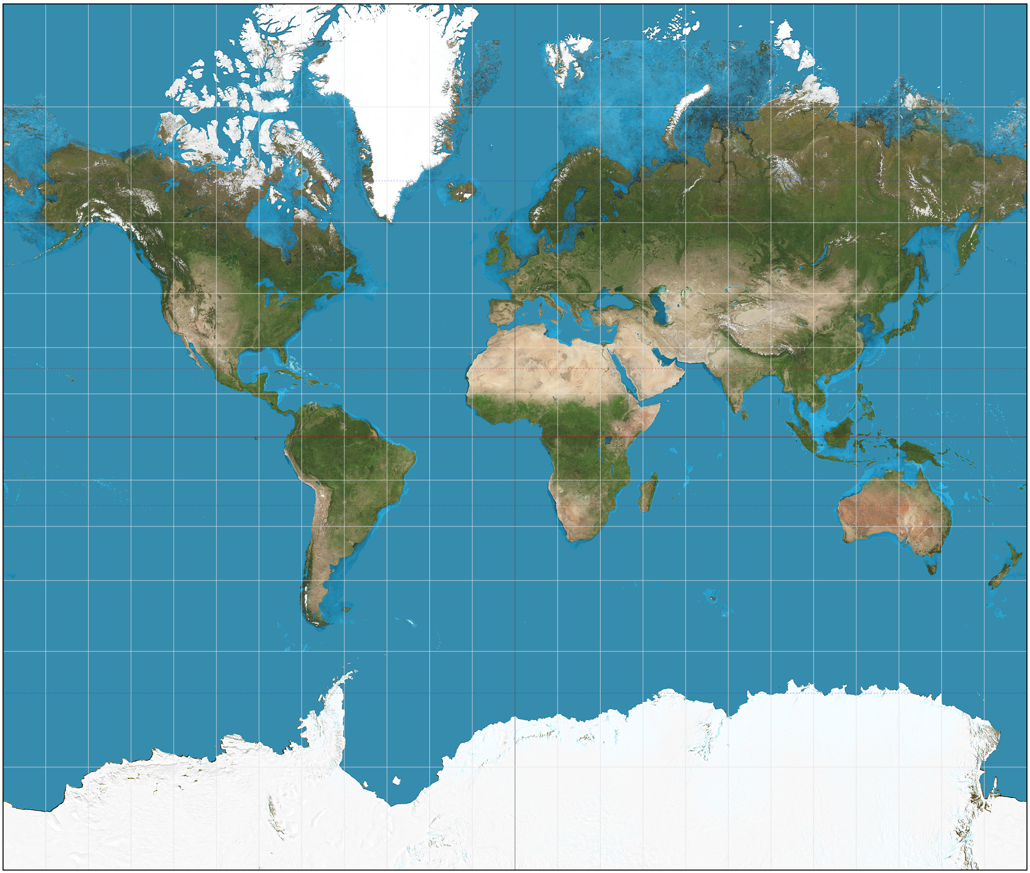
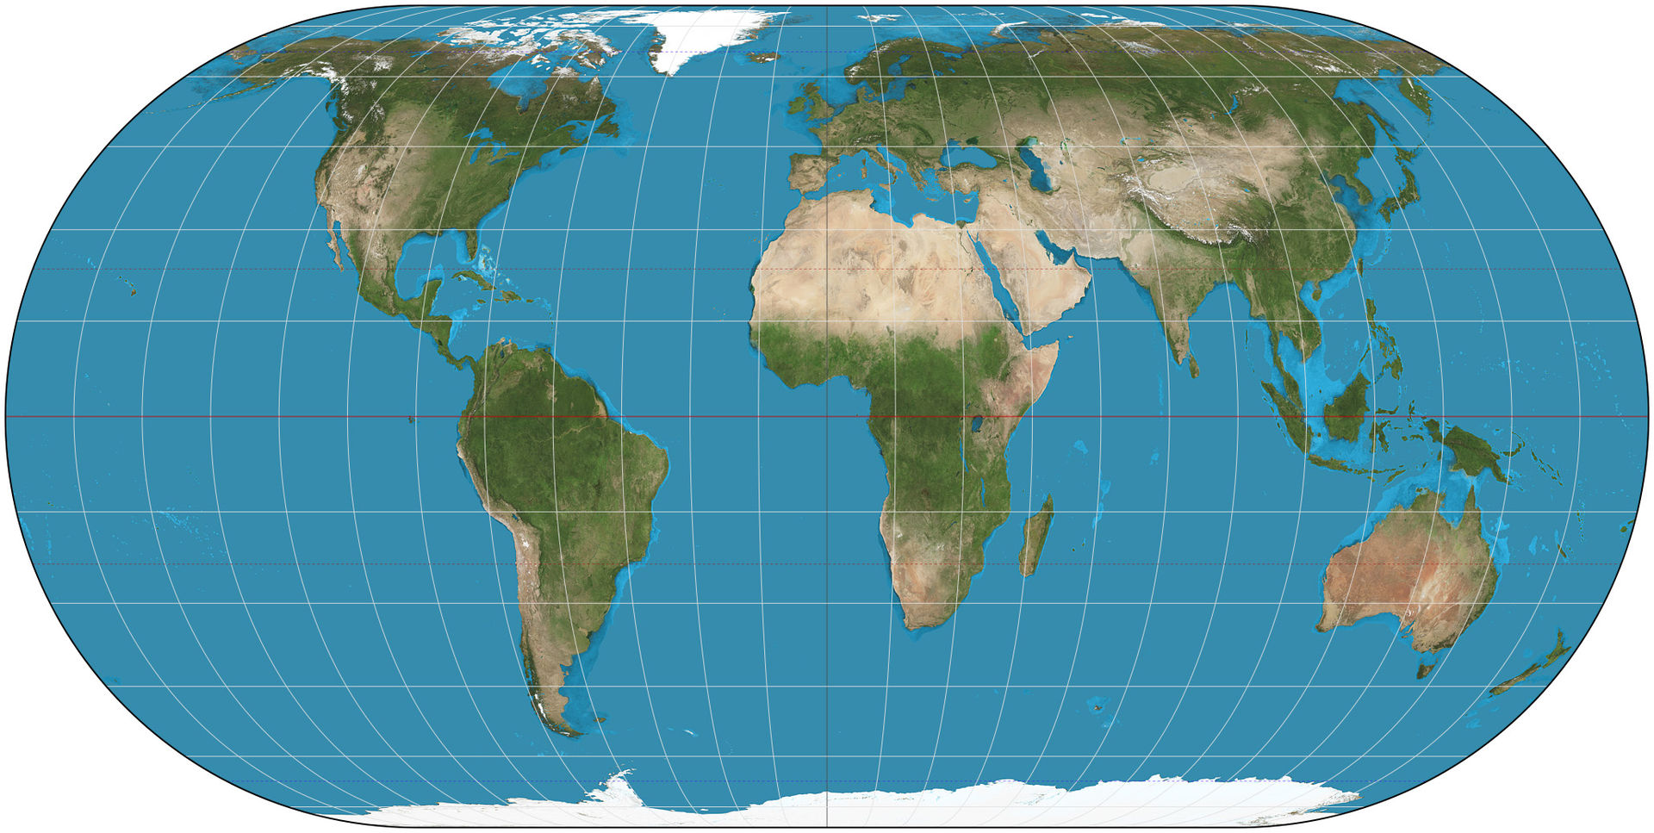
Projection Comparison
Equal area projection (Eckert IV)
Mercator Projection

Slide 13
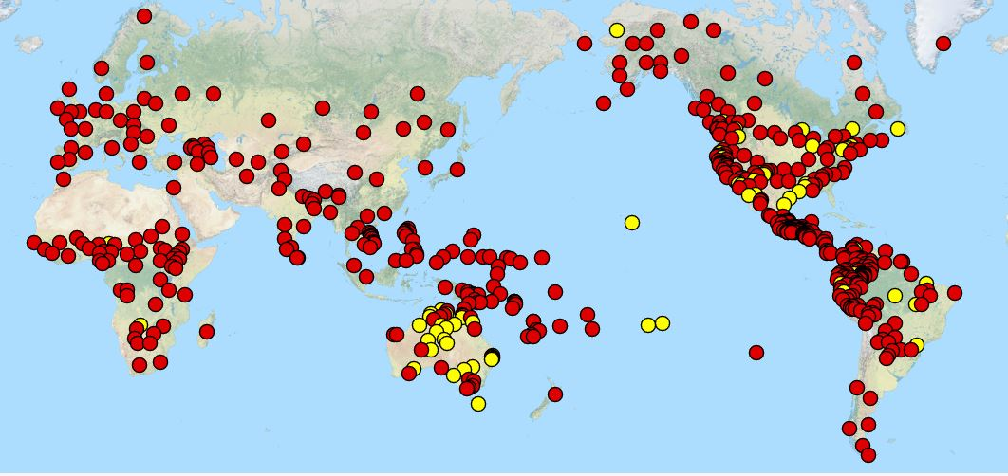
Data Visualization Methods
Many linguistic database visualizations also utilize point symbology to represent objects or features of interest. Below: WALS Chapter 130, Finger and Hand differentiation.
Notes:
<number>

Slide 14
Data Visualization Methods: Potential Solutions
Voronoi/Thiessen tessellation layer created from database inputs
These polygons are generated from a set of sample points. Each Thiessen polygon defines an area of influence around its sample point, so that any location inside the polygon (Euclidian distance wise) is closer to that point than any of the other sample points (esri).
Notes:
<number>

Slide 15
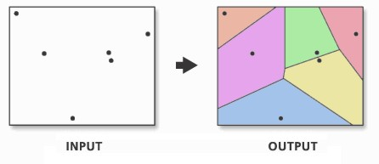
Data Visualization Methods: Thiessen Polygons
Notes:
<number>

Slide 16
Data Visualization Methods: Thiessen Tessellation
Notes:
<number>

Slide 17
Data Visualization Methods: Thiessen Tessellation
Notes:
<number>

Slide 18
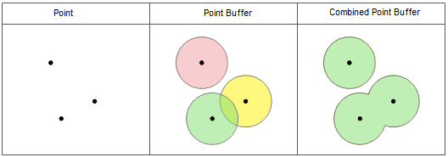
Data Visualization Methods: Thiessen Tessellation
An approach to solving this issue is to create a dissolved buffer around each point that created the polygons and use this buffer layer to “clip” the Thiessen polygon layer.
Notes:
<number>

Slide 19
Data Visualization Methods: Thiessen Tessellation
Notes:
<number>

Slide 20
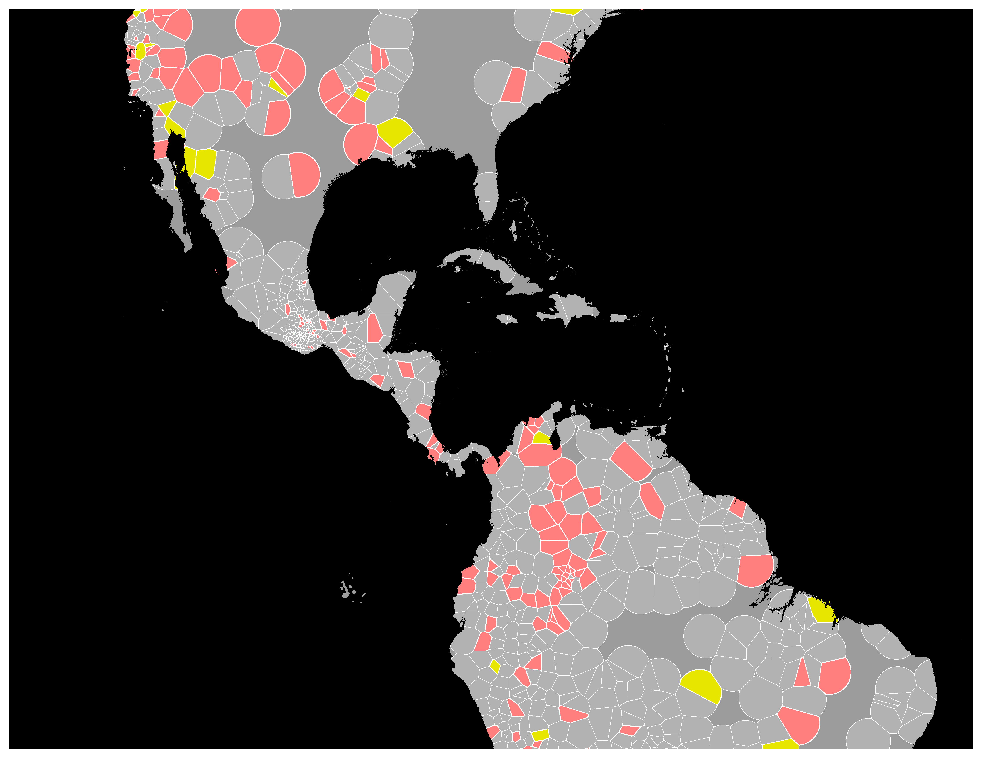
Data Visualization Methods: Thiessen Tessellation
Notes:
<number>

Slide 21
Data Visualization Methods: Visual Hierarchy
Notes:
<number>

Slide 22
Wrap Up – Moving Forward
Small land mass/Island emphasis symbology.
For these areas do not clip buffers to land features.
Overlay circular buffer
Selecting by attribute, i.e. land mass size drives decision
Saturation based coloring for population statistics.
Accounting for null, and all range of speaker populations
Other methods of representing languages as areal features
Raster based visualizations rather than vector based visualizations such as kernel density
Notes:
<number>

Slide 23
Wrap Up – Moving Forward
Potentially use ArcGIS for concept development
ArcGIS provides fast proof of concept. Much quicker than in D3/JS based web development.
Once proof of concept has been thoroughly tested, full deployment can migrate to a web based format, such as D3/JS
Notes:
<number>

Slide 24
Thank you!
Notes:
<number>

